Slide 1
WordCamp Davao 2019
WordPress Multi-site
AFFORDABLE AND EASY WAY
TO MANAGE MULTIPLE DOMAINS

Slide 2
Presentation Overview
KEY POINTS
A Short Introduction
What is Multi-Site (MU)?
The Key Features
Why it saves you time and money?
Tools/Services Needed to Start

Slide 3
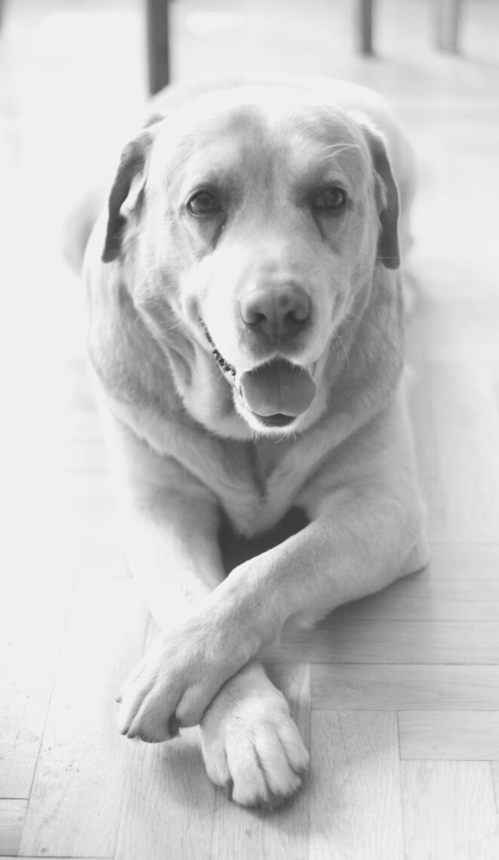
A Short Introduction
HAVE YOU HEARD ABOUT FULLY MANAGED WORDPRESS WEBSITE?
Offering a completely hassle-free experience, so clients can focus on running their business and doing what they are good at.
WordCamp Davao | Philippines 2019

Slide 4
WordPress
Multi-Site
RUNNING MULTIPLE WEBSITES MADE EASY
Having several websites/blogs, may they be in separate domains or sub-domains, in just one WordPress installation.

Slide 5
What is Multi-Site
(MU)
A WORDPRESS FEATURE
which allow users
TO CREATE NETWORK OF SITES
on a
SINGE WORDPRESS INSTALLATION.
https://www.wpbeginner.com/glossary/multisite/
WordCamp Davao | Philippines 2019

Slide 6
SUPER ADMIN INTERFACE
My Sites and Network Admin Menu/Tab on the upper left corner just right above the Dashboard
ADMIN INTERFACE
Normal WordPress Admin Menu, however the option to Add New Plugin and Add New Theme are not there.

Slide 7
THE KEY FEATURES
Run
MULTIPLE SITES
No need to log in separately to each individual website you manage .

Slide 8
Themes and Plugins Installed
CAN BE APPLIED TO ALL
No need to get individual licenses for each individual website.

Slide 9
Delegate an Admin/User
TO A SPECIFIC WEBSITE
Less worries that the website might break due to Theme modifications or Installation of "bad" Plugins.
WordCamp Davao | Philippines 2019

Slide 10
Why Multi-Site saves you time and money?
ONE INSTALLATION
Multiple Websites
Build New Sites Fast
ONE LICENSE
WORRY-FREE
Multiple Websites
Delegate with ease
You only spend once
Help others to help you

Slide 11
What do we want?
A SMART TOOL/PLATFORM.

Slide 12
Do more with less. Spend less with more.

Slide 13
WORDPRESS MULTI-SITE
The CMS for developers who understand the business needs.

Slide 14
What do you need to start?
DOMAIN
RELIABLE HOSTING
Choose a Registrar depending on your needs. (.com, .ph, .org, etc.)
Multisite requires mod_rewrite to be loaded on the Apache server.
THEME
PLUGIN
Focus only on 1 Theme and master it.
Install plugins that you only "need".

Slide 15
The Future Goal
BEING ABLE TO OFFER THIS TO BUSINESSES/INDIVIDUALS
You are wanted and needed. Businesses are paying $5,000 a year and higher for a managed WordPress website.

Slide 16
BEST PLATFORM AND SERVICE AT THE RIGHT PRICE
The Strategy
WordPress already provided you with the best platform for free. It is already up to you on how you use it.

Slide 17
What Sets You Apart?
ROBUST AND TRUSTED PLATFORM
Fastest growing and widely used CMS.
PROFESSIONAL DESIGN
Neat and responsive websites .
SAFE AND SECURE
WordPress core software is very secure, and it’s audited regularly.

Slide 18
FREE TOOLS AND PLATFORM
FREE STEP BY STEP GUIDES
FREE TO DO ANYTHING
WordPress offers a lot of free plugins and themes.
WordPress offers free learning materials.
WordPress lets you become the boss.
OFFER PAID SERVICES
OFFER LOWER
MONTHLY FEES
OFFER A SOLUTION
Make money with WordPress.
WordPress gives a price competitive advantage.
Wordpress is already a solution, all we need is to offer it.

Slide 19
THANK YOU
We offer rather than sell. We share rather than trade, and that's why I like WordPress.
RONALD JAY RAMA

