Slide 1
Drive Traffic & Earn from Your WordPress Site
Monetization and Marketing

Slide 2
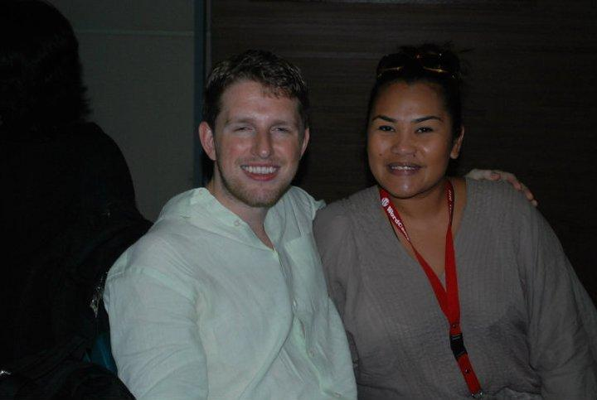
Introduction
My first encounter with
WordPress, Why we choose
to use it, for what reason and
Why we will continue to push
To use WordPress to eternity

Slide 3
Cost for WordPress
The cost of a WordPress site can be broken down into following categories:
WordPress hosting - $7.99 (P400) monthly
Domain Name - $12 (600) annually
Design - Ranges from Free to Php 100,000
Plugins and Extensions (Apps) - depending on your need
There are 54,000+ free plugins for WordPress. These are apps and extensions for your websites. Think features like contact form, gallery, etc.
It’s practically nothing but time is gold and how much do you actually value that and what value do you give TIME?

Slide 4
First Things First… When Building your WP Site
WHO
WHY
HOW
WHAT
Then decide
Look & Feel
Content
Flow & Action Steps
Monetization

Slide 5
PROVIDE VALUE
YOU
Your Audience
Merchants or Marketers

Slide 6
NO Traffic =No Honey=No Money
Get a following first then you have something they will come for.
Let the audience come, then the rest will follow
Use the power of Social Media to drive traffic
SEO can be your next step

Slide 7
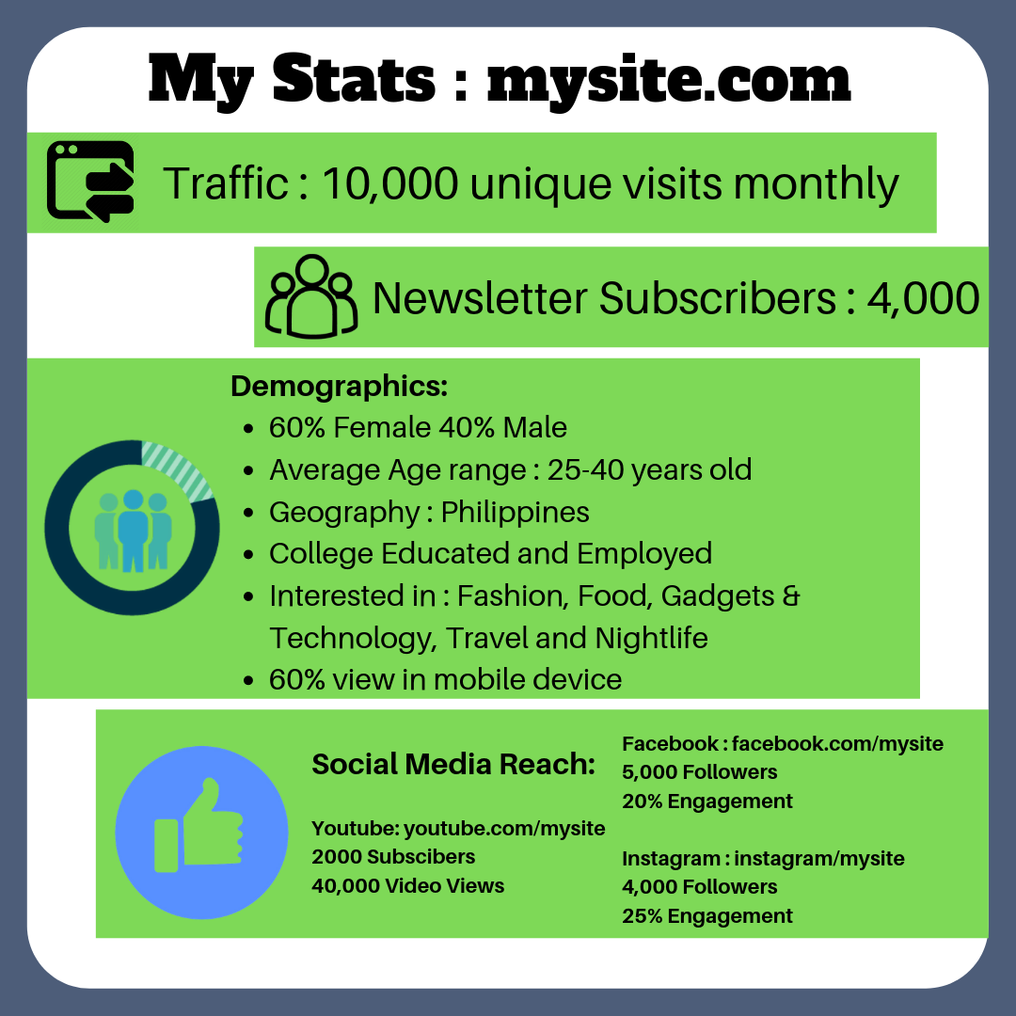
Know your site inside and out
Get to know the audience you are attracting - then, document!

Slide 8
NOW They have Arrived...what can you do?
Sponsor Ads/Email Marketing
Affiliate Marketing
Market Your Own Services

Slide 9
Sponsor Ads/Email Marketing
Selling ad space in your site where advertisers can gain visibility, trust and confidence for their product and services.
MUST HAVE TARGETTED TRAFFIC
Ad value to your readers by creating content to support your claims and add value to your advertisers by offering to collect emails and sending their first email campaign
Note: It’s easier to choose products and services you yourself believe in so it won’t feel like you’re working too hard or getting paid to say nice things
The bigger your reach the more money you can charge. Also depending on the price of the product or service offered.

Slide 10
Affiliate Marketing
Write reviews, how to tutorials, blogs or general things about your favorite topics and simply insert a suggested product that you can buy from your favorite shopping site.
EARN 6-10% of total cart value depending on the
Your content must be high quality and not sales-pitchy. You can also try to be creative. Meaning there is an expensive watch you will write about but you can offer a more affordable alternative by providing a photo and product link with your affiliate ID
You are paid by the number of people who click on your link to refer them to a shopping/retail site

Slide 14
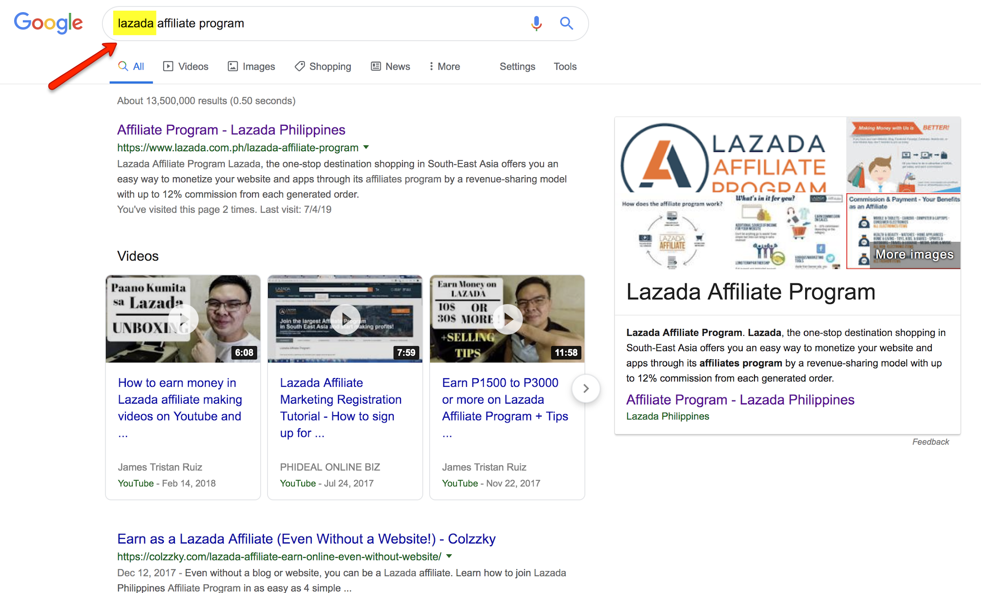

Slide 15
Self Promotion/Sell Your Own Services
“Show Off” your skills
Your site can speak for itself
Get your first clients as a freelancer

Slide 16
ASK ME ANYTHING
rica@nowcandoit.com

Slide 17
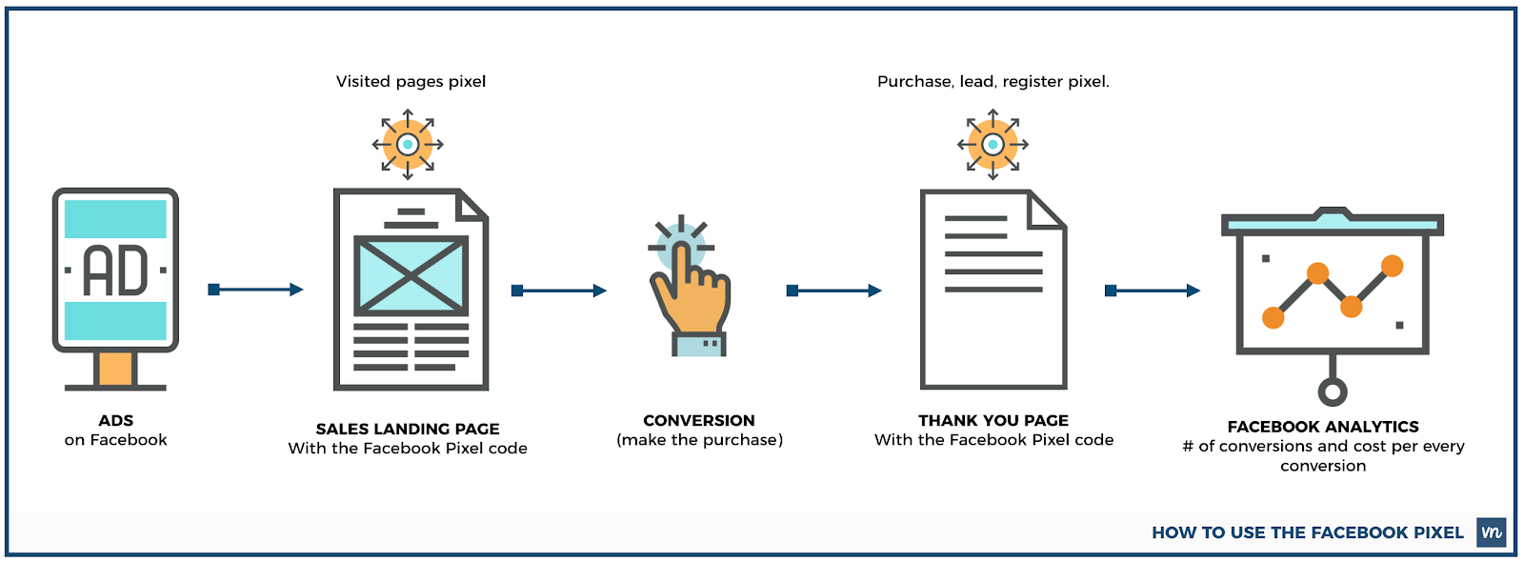
It takes money to make money - SPEND!
Use the power of Facebook or IG Ads + Pixels to drive traffic and create conversions
HOMEWORK: research FB Ads, Retargeting and Facebook Pixels

