Slide 1
How Expedite Your WordPress Development
Process By
Choosing The
Right Theme

Slide 2
ABOUT ANGIE
Freelance Front-end Developer / Mother / #WordPress #Ethuasist
Bookwormhead.com
Anj.bookwormhead
@anjbookworm

Slide 3
Two Ways In
Deciding What Theme To Use
Using a ready
made theme available in the market
Coding From
Scratch/Boilerplate theme

Slide 4
Ready Made Themes (FREE or Premium)
Pros
Cons
Expedite Your WordPress Development Process
Coding knowledge is not require
FREE or less expensive
Huge selection of themes
in the market
Unnecessary inline-style, css and functionality that you don't necessarily need
Updates Issues
Uniqueness/Originality
By Choosing The Right Theme
Shorter Development Time
Low Price
COding knowledge is not require
Huge selection of themes in the market
Cons:
Unncessary inline-style, css and functionality that you don't necessarily need
Updates Issues
Optimization
Warranty and support
Uniqueness

Slide 5
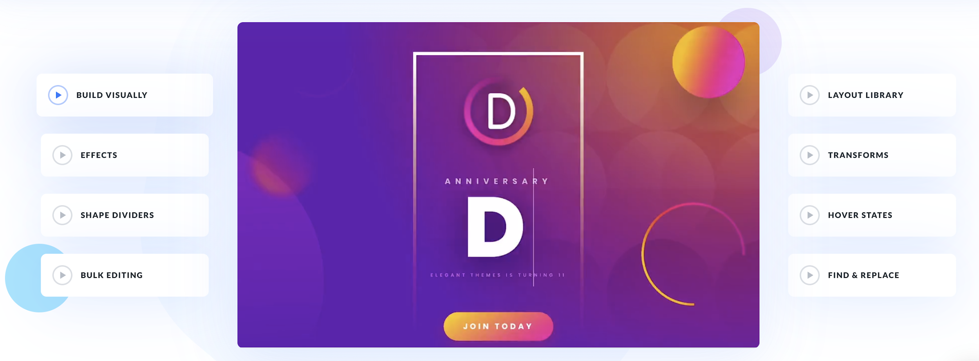
Recommended Themes

Slide 6
Using Boilerplate (Coding From Scratch)
Pros
Cons
Supports front-end framework
Supports backend framework
There’s no bells and whistles
Liteweight
You need to familiar WordPress codex
Require coding knowledge at least html, css and php specifically WordPress codex
You need to code from scratch
By Choosing The Right Theme
Shorter Development Time
Low Price
COding knowledge is not require
Huge selection of themes in the market
Cons:
Unncessary inline-style, css and functionality that you don't necessarily need
Updates Issues
Optimization
Warranty and support
Uniqueness

Slide 7
Recommended Boilerplate theme

Slide 8
Scenario

Slide 9
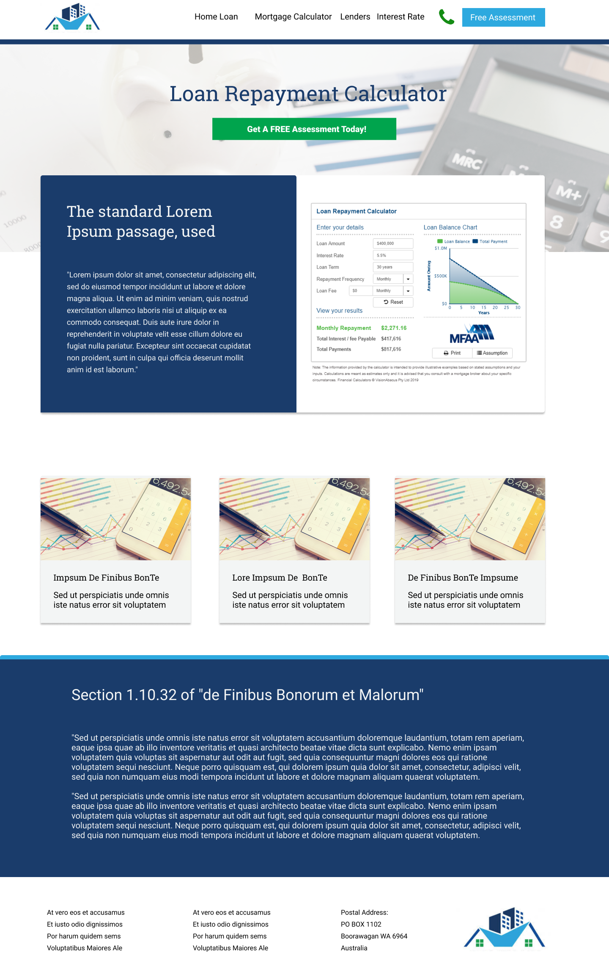
Client ABC
What He Needs
Header & CTA
Global hero banner with dynamic title and cta
2 column layout calculator with text
List of recent blogs
Full width text
Footers
Prototype Source: http://bit.ly/2MPqfLb

Slide 10
Boilerplate
Ready-Made
POINTS
POINTS
1 week turnaround
+1
+2
Limited budget
0
+2
Use friendly admin area
+1
+2
+1
+1
Winner: Ready-Made Theme | 7 POINTS
SEO Friendly

Slide 11
Setup your WordPress Development via:
Docker [tutorial below]
Link later
Or
XAMPP [tutorial below]
http://www.bookwormhead.com/how-to-setup-wordpress-offline-site/
Best for
Advanced
Best for
Beginners
This will not be discuss but you can check the link above for tutorial

Slide 12
LET’S START BUILDING

Slide 13
FontAwesome
Inject the fontawesome CDN on your Divi > Theme Options > integration
<link rel="stylesheet" href="path/to/font-awesome/css/font-awesome.min.css">
Go to WordPress dashboard > Widget > Menu > Add the inline html code on Navigation Label
<i class="fas fa-calculator"></i>

Slide 14
Echoing the Divi layout
Please make sure you install a child theme to avoid losing changes every time there’s new update available in Divi
Copy the php file in the child theme e.g page.php and add the echo the Divi layout do_shortcode hook
<?php echo do_shortcode('[et_pb_section global_module="000"][/et_pb_section]'); ?>

Slide 15
Recommendation after development: Always push you version in any version control system
Repository: mysite v1
Developer 1
Developer 2
Developer 3

Slide 16
Thank You!

